Slide 1
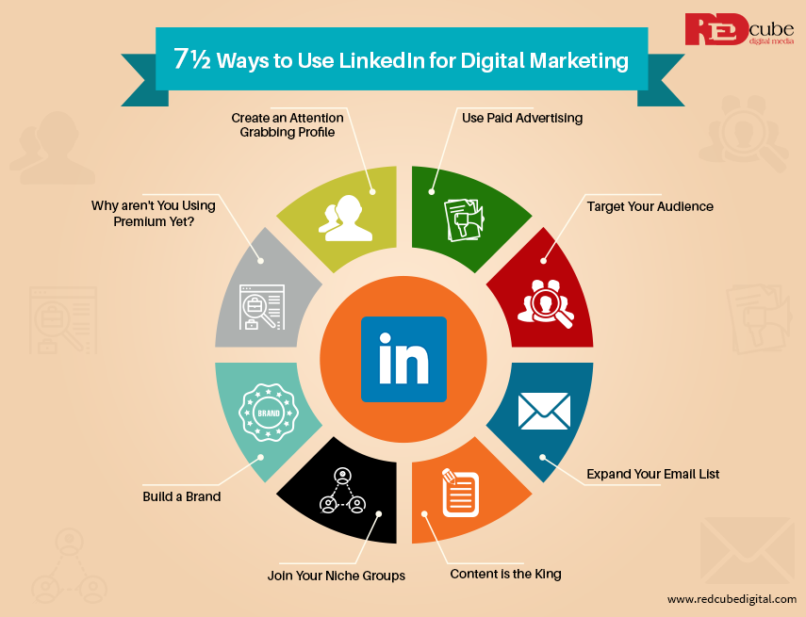
LinkedIn Marketing
Prepared by
Mrs. Rushali Navale

Slide 2
Introduction
LinkedIn marketing is a vital part of any digital marketing strategy, leveraging the platform's professional focus to build brand awareness, generate leads, and establish industry authority.
It involves using LinkedIn's features to connect with a targeted audience, share valuable content, and drive business goals.
By understanding LinkedIn's unique strengths and implementing effective strategies, businesses can significantly enhance their online presence and achieve their marketing objectives.

Slide 3
Key Aspects of LinkedIn Marketing:
Targeted Audience Engagement:
LinkedIn allows businesses to connect with specific professional demographics, including industry, job title, company, and more. This focused approach ensures that marketing efforts reach the most relevant audience, increasing the likelihood of engagement and conversions.
Content Marketing:
LinkedIn is a powerful platform for sharing valuable content, such as articles, posts, videos, and updates, to establish thought leadership and engage with the target audience.
Lead Generation:
LinkedIn's professional focus makes it an effective platform for generating high-quality leads. By sharing relevant content and engaging with potential customers, businesses can attract leads that are more likely to convert.
Building Brand Awareness:
LinkedIn helps businesses increase their brand visibility and awareness by showcasing their expertise, sharing company updates, and participating in relevant discussions.

Slide 4
continue
Networking and Relationship Building:
LinkedIn facilitates networking and relationship building with professionals in the industry, fostering connections that can lead to valuable partnerships and collaborations.
Advertising Capabilities:
LinkedIn offers various advertising options, including Sponsored Content, Sponsored Messaging, and Text Ads, to reach a wider audience and drive specific marketing goals.
Measuring Results:
LinkedIn provides analytics to track the performance of marketing campaigns, allowing businesses to assess the effectiveness of their strategies and make necessary adjustments.

Slide 5
Why LinkedIn is Important for Digital Marketing:
Professional Focus:
Unlike other social media platforms, LinkedIn's professional focus allows businesses to connect with a highly targeted audience of decision-makers and industry influencers.
B2B Focus:
LinkedIn is particularly valuable for B2B marketing, enabling businesses to connect with other businesses and professionals who are potential customers or partners.
SEO Potential:
LinkedIn profiles, pages, and articles have strong SEO potential, making it easier for people to find businesses and their content through search engines.
By integrating LinkedIn into their digital marketing strategies, businesses can leverage the platform's unique features to achieve their marketing objectives, build a strong online presence, and drive growth.

Slide 6
Importance of LinkedIn Presence
A strong LinkedIn presence is crucial for both individuals and businesses in today's professional landscape. It allows for networking, building a professional brand, attracting opportunities, and showcasing expertise. For businesses, it's a powerful tool for recruitment, lead generation, and establishing brand visibility and credibility.
- For personal branding: resumes, connections, authority. - For businesses: hiring, networking, thought leadership. - Show real LinkedIn profiles (student + brand pages).

Slide 7
For Individuals
Professional Networking: LinkedIn is a hub for connecting with colleagues, industry leaders, and potential employers.
Career Advancement: Building a strong profile and engaging with content can lead to new job opportunities, promotions, and career growth.
Personal Branding: Sharing your thoughts, experiences, and skills helps establish your unique professional identity.
Thought Leadership: Sharing valuable content positions you as an expert in your field.
Staying Informed: LinkedIn provides access to industry news, insights, and trends.

Slide 8
For Businesses:
Brand Building:
A LinkedIn presence helps showcase your company culture, values, and expertise, enhancing brand awareness and reputation.
Recruitment:
LinkedIn is a primary tool for attracting top talent and building a strong team.
Lead Generation:
By sharing valuable content and engaging with potential clients, businesses can generate leads and drive sales.
Client Acquisition:
LinkedIn helps connect with potential clients and build relationships.
Market Research:
Businesses can use LinkedIn to research their industry, competitors, and potential customers.

Slide 9
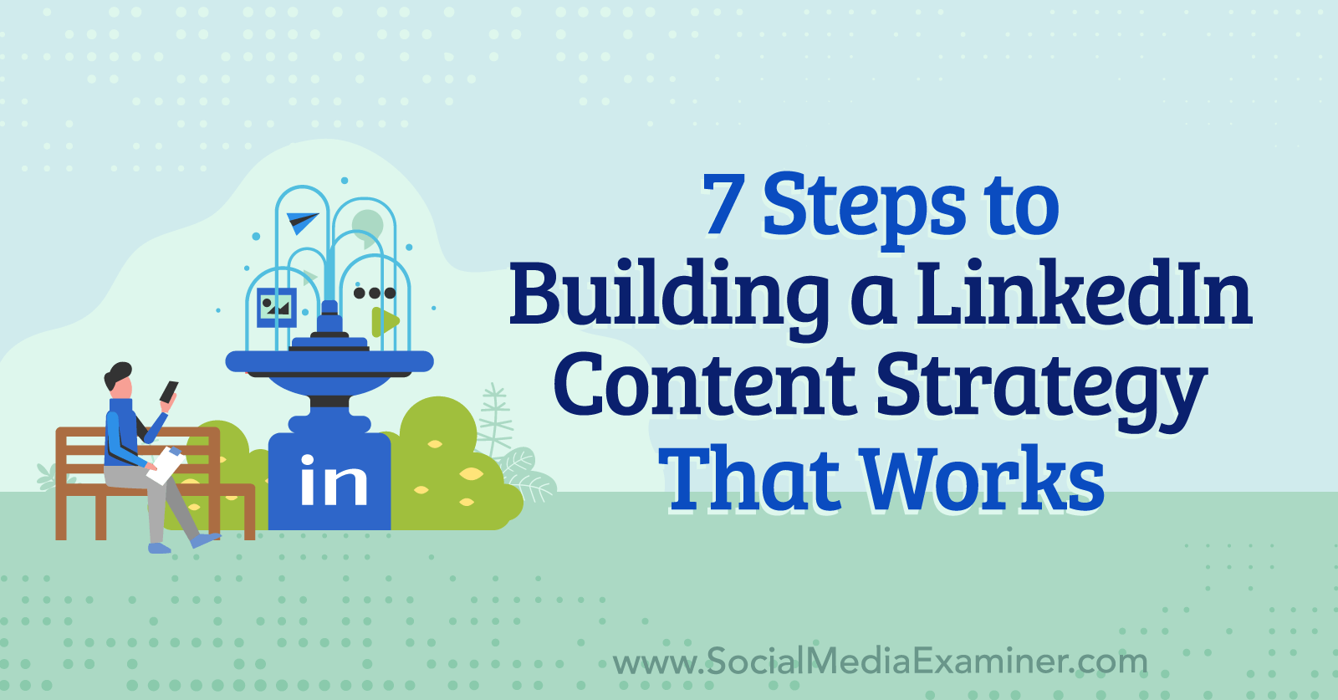
LinkedIn Strategy

Slide 10
Introduction
A LinkedIn content strategy is a plan for creating and sharing content on LinkedIn to achieve specific goals, such as building brand awareness, generating leads, or establishing thought leadership.
It involves defining your target audience, crafting engaging content, and strategically distributing that content.
Effective strategies also consider the professional yet relatable tone needed for LinkedIn, and the importance of consistent engagement.

Slide 11
1. Define Your Goals and Target Audience:
Goals:
What do you want to achieve on LinkedIn? (e.g., increase brand awareness, generate leads, establish thought leadership, drive website traffic).
Target Audience:
Who are you trying to reach? (e.g., specific industries, job titles, company sizes, interests).

Slide 12
2. Content Strategy:
Content Pillars:
Identify key topics and themes relevant to your audience and goals.
Content Formats:
Utilize various formats like text posts, images, videos, articles, carousels, and polls.
Content Tone:
Maintain a professional yet relatable tone, balancing expertise with a human touch.
Frequency:
Establish a consistent posting schedule that aligns with your goals and audience engagement patterns.
Value:
Focus on providing value to your audience through informative, engaging, and actionable content.

Slide 13
3. Distribution Strategy:
Organic Reach:
Maximize your reach through relevant hashtags, engaging with your audience, and participating in relevant groups.
Paid Promotion:
Consider using LinkedIn Ads for targeted campaigns to reach specific audiences.
Employee Advocacy:
Encourage employees to share and engage with your content to expand your reach.

Slide 14
4. Engagement and Analysis:
Active Engagement:
Respond to comments, messages, and participate in discussions to build relationships.
Track Performance:
Monitor your LinkedIn analytics to assess the effectiveness of your content and adjust your strategy accordingly.

Slide 15
5. Key Considerations:
Authenticity: Be genuine and transparent in your content to build trust and credibility.
Adaptability: Continuously evaluate and refine your strategy based on performance and feedback.

Slide 16
Key Aspects of LinkedIn Ad Campaigns:
Targeting Options: LinkedIn provides a wide range of targeting criteria, including demographics (location, industry, job title, seniority),company attributes (size, industry, followers), and even interests and traits.
Audience Segmentation: Break down your target audience into smaller, more specific segments based on various attributes to create more tailored ad experiences.
Account-Based Marketing (ABM): Leverage account targeting to match your target companies against LinkedIn pages, enabling you to run ABM campaigns and guide decision-makers through their buying journey.
Website Retargeting: Re-engage website visitors by targeting them with ads based on their browsing behavior on your site.
Conversion Tracking: Implement LinkedIn's insight tag to track conversions and measure the effectiveness of your campaigns in driving desired actions.
LinkedIn Analytics: Utilize LinkedIn analytics to gain insights into your audience demographics, content engagement, and overall campaign performance.
Campaign Optimization: Continuously analyze campaign performance, adjust targeting based on data, and A/B test different ad creatives and targeting strategies to maximize ROI.

Slide 17
Best Practices for LinkedIn Ad Campaigns:
Start with clear objectives: Define your goals (e.g., lead generation, brand awareness) and choose the appropriate ad format and targeting options.
Build a solid audience: Identify the ideal audience for your product or service and leverage LinkedIn's targeting features to reach them effectively.
Utilize funnel-based targeting: Start with broad awareness campaigns (top of the funnel), retarget engaged audiences (middle of the funnel), and focus on high-intent conversions (bottom of the funnel).
Optimize audience size: Aim for a target audience size that is large enough to generate sufficient reach but not so broad that it dilutes your message.
Monitor and adjust: Regularly analyze campaign performance metrics (CPC, CPM, conversion rate, etc.) and adjust your targeting and ad creative accordingly.
Test and iterate: Experiment with different targeting options, ad creatives, and bidding strategies to identify what works best for your specific goals and audience.

Slide 18
Targeting ad campaign in linkedin
LinkedIn allows advertisers to target specific audiences based on professional attributes like job title, seniority, skills, and company information, as well as demographics like location and interests.
You can also target based on company size and industry.
Additionally, LinkedIn offers features like Account Targeting for account-based marketing (ABM) campaigns and Website Retargeting to re-engage website visitors.

Slide 19
1. Professional Targeting:
Job Experience: Target by job title, function, seniority, skills, and years of experience.
Company: Target by company name, industry, size, and even specific company pages.
Interests and Traits: LinkedIn allows targeting based on member interests and traits, which can be quite granular.

Slide 20
2. Demographic Targeting:
Location: Target by country, region, city, or even specific postal codes.
Age and Gender: LinkedIn allows targeting based on age and gender, although this is less granular than professional targeting.

Slide 21
3. Custom Audiences:
Matched Audiences:
Upload your own contact and company lists to target specific individuals and organizations.
Predictive Audiences:
Leverage LinkedIn's algorithms to identify members who are most likely to be interested in your products or services.

Slide 22
4. Account-Based Marketing (ABM):
Account Targeting: Match your target companies against LinkedIn's company pages to run ABM campaigns and guide decision-makers.

Slide 23
5. Website Retargeting:
Retargeting: Re-engage website visitors by targeting them with ads based on the pages they visited on your site.

Slide 24
6. Other Options:
AND/OR Functionality:
Use AND/OR operators to combine or exclude different targeting attributes for more precise audience definition.

Slide 25
Campaign Manager:
Use LinkedIn's Campaign Manager to create and manage your ad campaigns, including defining your target audience.

